Slide 1

RViT – A requirement and value identification tool for prioritisation
Niamh Gillespie – 2549880G

Slide 2
Introduction & Motivations
Current agile project management tools are often challenging to set up with overly complex user interfaces and a steep learning curve.
Current tooling also does not tend to place emphasis on the business value that an epic or user story contains. This can lead to the perceived business value differing between stakeholders and developers.

Slide 3
Background
Just-in-time refinement is often used in agile teams to identify requirements and scope epics and user stories.
The kanban framework can be used to visualise a team’s flow of work.
Visible business values may make it easier for developers to prioritise work and may also change their approach to developing an epic or user story.
Three existing agile project management tools were reviewed to identify strengths and weaknesses.
Atlassian’s Jira
Atlassian’s Trello
GitHub’s Projects

Slide 4
Requirements Identification
Requirements identification followed waterfall approach due to time constraints.
User Scenarios
User Stories
Functional Requirements
Identification process for functional requirements
Non-functional requirements were identified through analysing expected user needs and expectations.

Slide 5
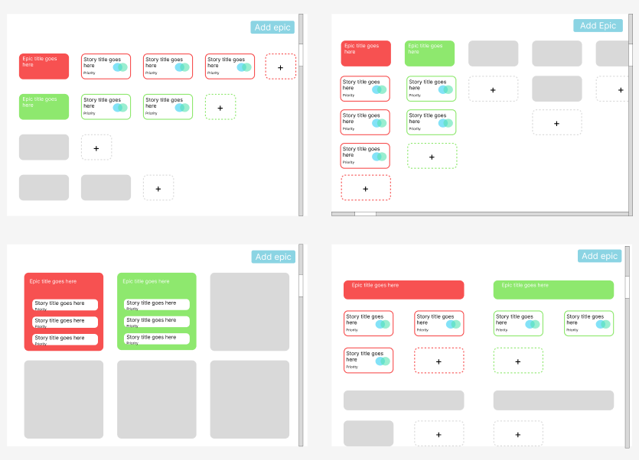
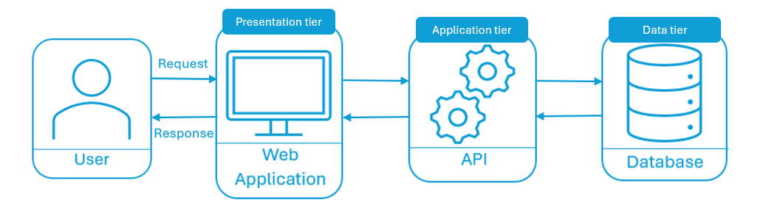
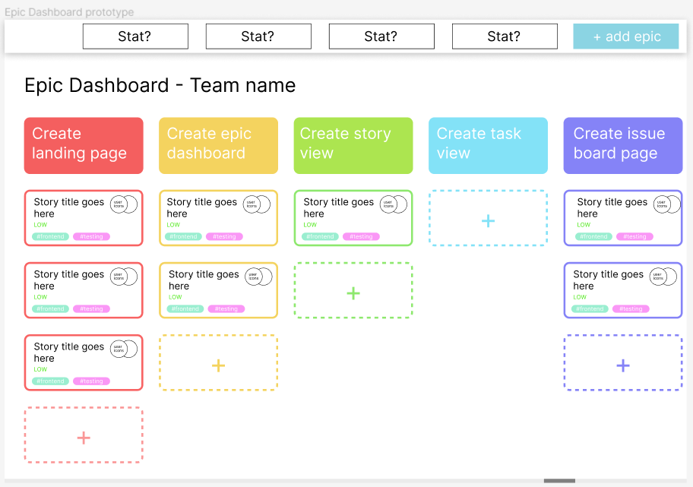
Design
System architecture based off the three-tier architecture pattern.
Initial low-fidelity designs for the Epics Dashboard
Initial web pages designed on Figma.
Chose to use Django and React JS for development.
Finalised high-fidelity design for the Epics Dashboard, focusing on the role of colour

Slide 6
Implementation
A variety of software engineering techniques were used throughout the development of RViT.
Continuous Integration
Agile Project Management
Sprint-based Development
Code Refactoring
The frontend is built with a component-based architecture to allow the reuse of components.
Deployed REST API on Python Anywhere and React JS web application on Netlify.

Slide 7



Non-Functional Evaluations
Unit Testing
Performance and Accessibility
Security
96% Django statement coverage.
32% React JavaScript branch coverage.
..
.
9 vulnerable packages.
4 cross-site scripting vulnerabilities.
31 hardcoded credentials used.
Average performance: 98%
Average accessibility: 90%
Average best practices: 96%

Slide 8
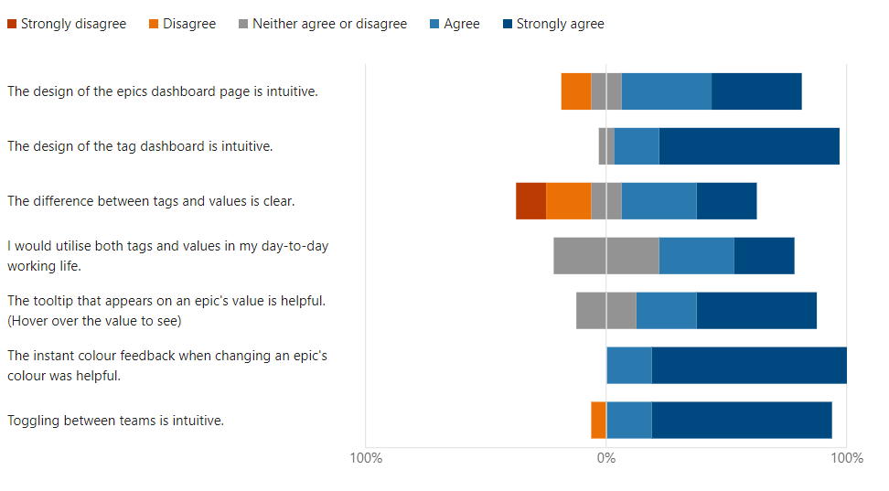
Usability Evaluation
User evaluation split into three sets of tasks and one section for final comments.
20 full-time developers were recruited for the evaluation, four were asked to complete the pilot study while the others completed the finalised evaluation.
“RViT proved to be far simpler and more user-friendly compared to other tools I've used in the past, such as Jira. … with RViT, I was able to complete tasks swiftly and effectively, as its intuitive design made everything straightforward“- quote from a user evaluation participant
Graph showing how much participants agreed or disagreed with the list of specified statements surrounding the Tag and Epics Dashboards

Slide 9
Conclusions
Achieved all the must and should have requirements, with positive outcomes from the various evaluations conducted.
Many future development opportunities.
Upon reflection, earlier evaluations would have been extremely helpful.

